Slide 1

Optimizing Early Infant HIV Diagnosis through the Introduction of Point of Care Testing
Post-Market Surveillance
Case Study
Lesotho, October 2017

Slide 2
Post Market surveillance
Post-marketing surveillance (PMS) (also post market surveillance) is the practice of monitoring the safety of a pharmaceutical drug or medical device after it has been released on the market and is an important part of the science of pharmacovigilance.

Slide 3
Why ?
Devices offer opportunities for improved diagnosis and management of disease, they also can carry substantial risks.
Gvt & Regulatory bodies need to balance the goals of expanding therapeutic options with safeguarding public health
In recognition of the importance of medical devices, the WHO established a Medical Device Unit
  focus research and policy on prioritizing access to medical devices in low-resource settings
  Dissemination of innovations, and
  Training of biomedical personnel to support the use of devices worldwide
Notes:
While medical
devices offer opportunities for improved
diagnosis and management of disease, they
also can carry substantial risks. Governmental
regulatory bodies considering new
medical device approval balance the goals
of expanding therapeutic options with
safeguarding public health

Slide 4
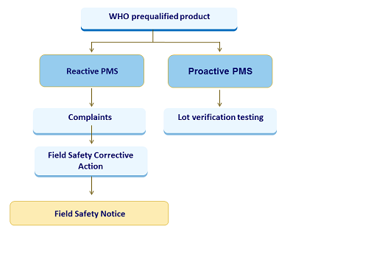
Two Types of PMS
Notes:
Post-market surveillance consists of reactive post-market surveillance after an issue has occurred related to the IVD, and proactive post-market surveillance to scan for potential issues related to the IVD.

Slide 5
Reactive Post-market Surveillance
Complaint reporting, including vigilance of mild, moderate and severe adverse events
Evaluation of data from external quality assessment schemes (proficiency testing)
End-user quality control programmes.
Notes:
Reactive post-market surveillance activities include:
Complaint reporting, including vigilance of mild, moderate and severe adverse events;
Evaluation of data from external quality assessment schemes (proficiency testing); and
end-user quality control programmes.

Slide 6
Proactive Post-market Surveillance Activities
Lot verification testing (pre-distribution and post-distribution to end-users).
Lot verification testing aims to identify any catastrophic product failure and to determine variation from lot to the next.
Lots may either be consecutively or randomly sampled for testing on a panel of well-characterised biological specimens.
Notes:
Proactive post-market surveillance activities include:
Lot verification testing (pre-distribution and post-distribution to end-users).
Lot verification testing aims to identify any catastrophic product failure and to determine variation from lot to the next. Lots may either be consecutively or randomly sampled for testing on a panel of well-characterised biological specimens.

Slide 7
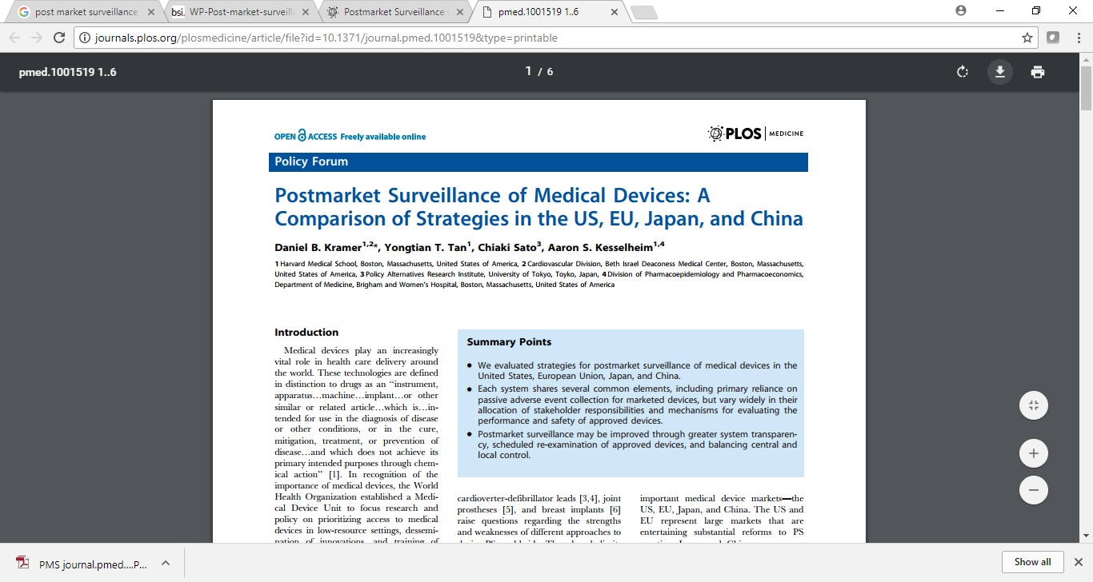
evaluated strategies for PMS of medical devices in the United States, European Union, Japan, and China.
Several common elements, including primary reliance on passive adverse event collection for marketed devices, but vary widely in their allocation of stakeholder responsibilities and mechanisms for evaluating the performance and safety of approved devices.
Greater system transparency, scheduled re-examination of approved devices, and balancing central and local control
Notes:
We evaluated strategies for postmarket surveillance of medical devices in the United States, European Union, Japan, and China.
Each system shares several common elements, including primary reliance on passive adverse event collection for marketed devices, but vary widely in their allocation of stakeholder responsibilities and mechanisms for evaluating the performance and safety of approved devices.
Postmarket surveillance may be improved through greater system transparency, scheduled re-examination of approved devices, and balancing central and local control

Slide 8
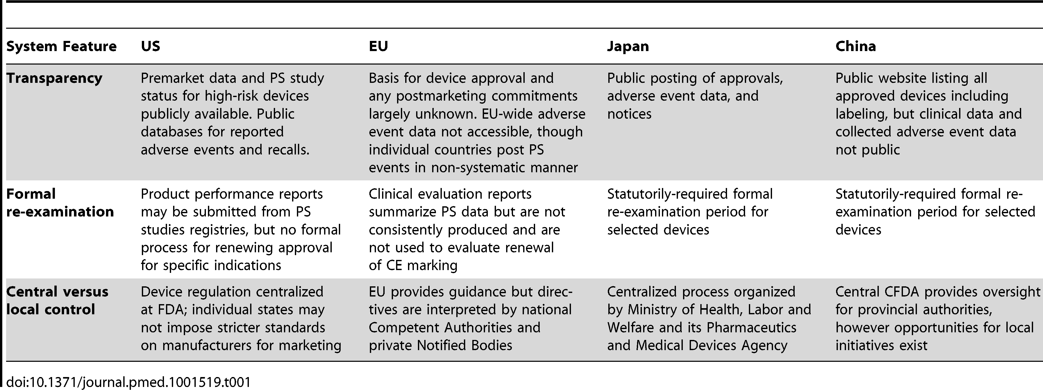
Key features of four device post-market surveillance systems
Daniel B et al, 2013, Plos Medicine
https://doi.org/10.1371/journal.pmed.1001519.t001

Slide 9
Example of IQC failures analysis reporting in Lesotho
Sources
IQC failure Incident log at testing site
WhatsApp group of Qaulity Assurance Officers and users
IQC failure, Invalid and No Result Analysis Report
Maintenance log
Notes:
during the monthly maintenance, the instrument assay and specimen reports were also downloaded and provided another level of data quality check in terms of reported tests and errors reported on Error and incidence logs

Slide 10
IQC Failure, Invalid And No Result Analysis Report

Slide 11
Example of IQC failure analysis reporting in Lesotho
In February, the Alere rate peaked at 9.3%. Recurrent IQC failures suggested possible causes related to dirty instrument optics and incorrect cartridge loading. Corrective actions, taken in early March included use of powder-free gloves and retraining of end-users on key pre-analytical steps of testing; no further errors on the Alere assay were detected from mid-March on
Notes:
In February, the Alere rate peaked at 9.3%. Recurrent errors suggested possible causes related to dirty instrument optics and incorrect cartridge loading. Corrective actions, taken in early March included use of powder-free gloves and retraining of end-users on key pre-analytical steps of testing; no further errors on the Alere assay were detected from mid-March on

Slide 12
Process followed to report the Cepheid cartridges problem to WHO-PQ
EGPAF reached out to Cepheid regarding lot Lot 30401 and Lot 30502
Cameroon had similar rates for the same Lot numbers (56 %)
site | started testing | number of tests since 27 March to 14 July 2017 | total # of errors | overall IQC error rate | # of IQC error 5016 only | Proportion of Code 5016 | overall error rate excluding code 5016
Mafeteng | 22-Dec-16 | 456 | 34 | 7% | 20 | 59% | 3%
Likotsi | 2-Jan-17 | 123 | 10 | 8% | 7 | 70% | 2%
Maluti SDA | 8-Jun-17 | 164 | 16 | 10% | 8 | 50% | 5%
Seboche | 6-Jun-17 | 60 | 5 | 8% | 2 | 40% | 5%
Totals Xpert |  | 803 | 65 | 8% | 37 | 57% | 3%
Notes:
Lot 30401 received 23rd March 2017
Lot 30502 received 15 May 2017
- Error code 5016 on Gene Xpert – became frequent, associated with cartridge- post run analysis, frequent errors mean more samples recollected. Cepheid had pledged to replace the lost cartridges. It was associated with cartridges of lot 30502. However, without this error code – the overall error rates remain close to manufacturer claims of 5% thereabout

Slide 13
Sharing with the Consortium
Irregularities noticed for Xpert HIV-1 Qual cartridge lots 30401 and 30502
From kits lot 1000055129 and 1000057681 respectively)
Expiry dates of 2017-06-25 and 2017-12-10
Cepheid voluntarily credited us cartridges to account for the number of 5016 codes obtained while they are performing further investigation.

Slide 14
Officially notified WHO-PQ
Diagnostic Advisor notified WHO on 10 Aug 2017
A post-market surveillance effort
For proper documentation, investigation and dissemination.
Recalled the lots in question from sites mid Aug
preliminary investigations- “a change was made to the product to ameliorate the possibility for false “HIV-1 detected” results, had an unintended consequence of increasing errors than before.”
1 month post recall – error 5016 significantly reduced

Slide 15
Example of IQC failure analysis reporting in Lesotho
Fig 1- Monthly IQC failure rates from Jan – Aug 2017
IQC failure reporting log was introduced for clinic end-users (health workers) to investigate all failures
IQC failures observed in the first five months (January-May 2017) of routine clinical use of the two POC assays in three maternal and child health clinics were analyzed monthly for event counts and error/invalid types

Slide 16
This document was made possible thanks to Unitaid’s support. Unitaid accelerates access to innovation so that critical health products can reach the people who most need them.
For more information, please contact: The EGPAF Innovation and New Technology Team at (innovation@pedaids.org). www.pedaids.org | www.unitaid.org

